Slide 1
Divide and Conquer
Session 07
Henry Lucky, S.Kom. M.Kom.

Slide 2
Outline Materials
Session 07
Divide and Conquer and Recurrence
Matrix multiplication
Strassen’s algorithm for matrix multiplication

Slide 3
Learning outcomes
07
LO 1: Explain fundamental concept of analysis algorithms
LO 2: Apply algorithm techniques and methods
LO 3: Solve a problem using specific algorithm.
LO 4: Compare several algorithm design methods

Slide 4

Divide-and-conquer and recurrences
Algorithmic recurrences
In previous session, we have learned about recurrences.
In this session, we formally define algorithmic recurrences:
A recurrence $T(n)$is algorithmic if, for every sufficiently large threshold constant $n>n_{0}$, the following two properties hold:
For all $n<n_{0}$, we have $T(n)=Θ(1)$.
For all $n≥n_{0}$, every path of recursion terminates in a defined base case within a finite number of recursive invocations.

Slide 5

Divide-and-conquer and recurrences
Conventions for recurrences
We adopt the following convention:
Whenever a recurrence is stated without an explicit base case, we assume that the recurrence is algorithmic.
Asymptotic solutions of algorithmic divide-and-conquer recurrences also don’t tend to change when we drop any floors or ceilings in a recurrence defined on the integers to convert it to a recurrence defined on the reals.
You may sometimes see recurrences that are not equations, but rather inequalities, such as $T\left(n\right)≤2T\left(n/2\right)+Θ(n)$. Here, we use O-notation for the solution rather than $Θ$-notation because the recurrence states only the upper bound of $T\left(n\right)$..

Slide 6

Matrix multiplication
Problem definition
Here, we only focus on multiplying square matrices.
Let $A=(a_{jk})$ and $B=(b_{jk})$ be square $n × n$ matrices. The product $C=A∙B$ is also an $n × n$ matrix, where for $i, j=1, 2, …, n,$the $(i, j)$ entry of C is given by:
$c_{ij}=\sum_{k=1}^{n}{a_{ik}∙b_{kj}}$
Now, our procedure implements this strategy using three $n × n$ matrices as input, A, B, and C, and it adds the matrix product $A∙B$ to $C$.
Thus, it computes $C=C+A∙B$ instead of just $C=A∙B$.
So, we need to initialize all $n^{2}$ entries of C to 0 before calling the procedure, which takes an additional ${Θ(n}^{2})$ time.
We will see that the cost of matrix multiplication asymptotically dominates this initialization cost.

Slide 7
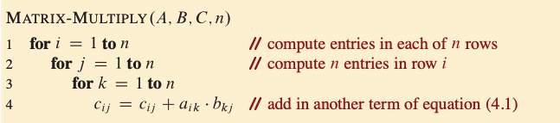

Matrix multiplication
Problem definition
Based on the procedure, we can tell that it operates in ${Θ(n}^{3})$, because triply nested for loops runs for exactly n iterations and line 4 takes constant time.
Even if we add ${Θ(n}^{2})$ time for initializing C to 0, the running time is still ${Θ(n}^{3})$.

Slide 8
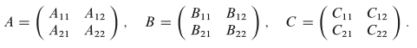
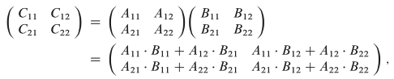

Matrix multiplication
Simple divide-and-conquer algorithm
Let’s see how to compute the matrix product $A∙B$ using divide-and-conquer. For $n>1$, the divide step partitions the $n×n$ matrices into four $n/2×n/2$ submatrices.
We’ll assume that n is an exact power of 2, so that as the algorithm recurses, we are guaranteed that the submatrix dimensions are integer.
The divide step views each of the $n×n$ matrices $A, B, C$ as four $n/2×n/2$ submatrices:
Then, we can write the matrix product as:
We can see it has 4 equations which consist of 4 additions and 8 multiplications of n/2 X n/2 submatrices

Slide 9

Matrix multiplication
Simple divide-and-conquer algorithm
To transform the equation to an algorithm, there are two common approaches for implementing the matrix partitioning:
Allocating temporary storage and copying all submatrices which take $Θ(n^{2})$ time, since ${3n}^{2}$ elements are copied
Index calculations which takes $Θ(1)$ time, since it only involves arithmetic on the location information
Going forward, we’ll assume that index calculations are used and that partitioning can be performed in $Θ(1)$ time.

Slide 10
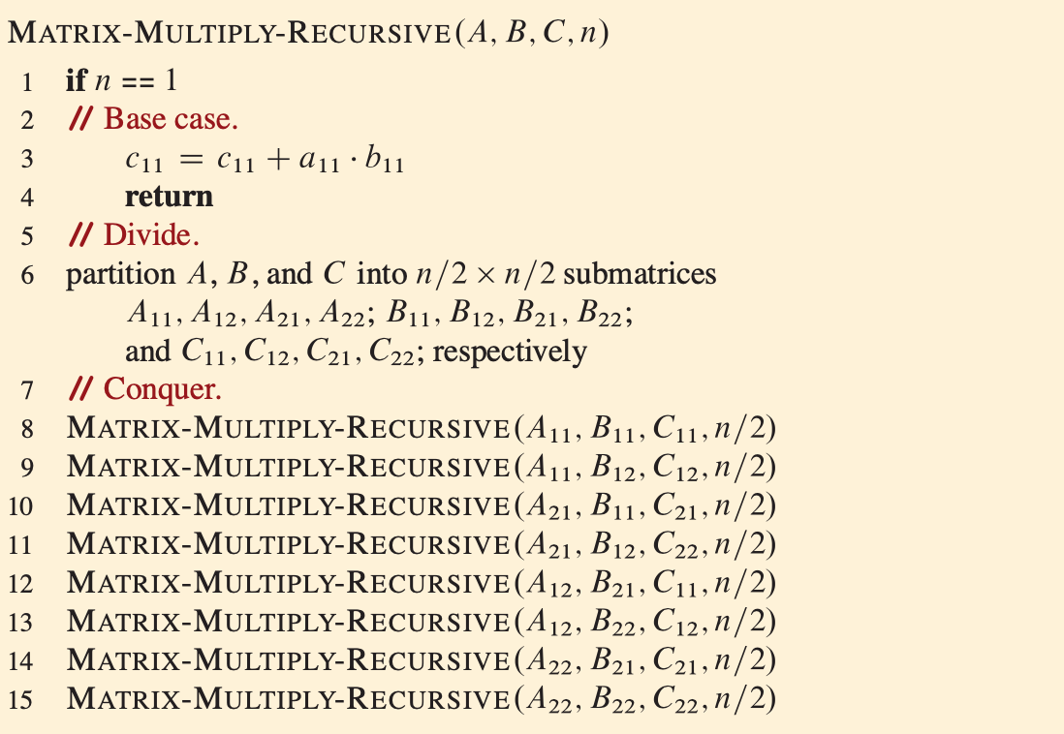
Matrix multiplication
Simple divide-and-conquer algorithm

Slide 11

Matrix multiplication
Simple divide-and-conquer algorithm
In the base case, when n=1, line 3 performs just the one scalar multiplication and one addition, which means that $T\left(n\right)=Θ(1)$. As is our convention for constant base cases, we can omit this base case in the statement of the recurrence.
The recursive case occurs when n>1. As discussed, we’ll use index calculations to partition the matrices in line 6, taking $Θ(1)$ time. Lines 8-15 recursively call MATRIX-MULTIPLY-RECURSIVE a total of eight times.
The first four recursive calls compute the first terms of equations in matrix before and the subsequent four recursive calls compute and add in the second terms.
Because each recursive call multiplies two n/2 X n/2 matrices, thereby contributing $T\left(n/2\right)$ to the overall running time, the time taken by all eight recursive calls is $8T\left(n/2\right)$.
There is no combine step, because the matrix is updated in place, thanks to index calculations.

Slide 12

Matrix multiplication
Simple divide-and-conquer algorithm
Therefore, our recurrence for the running time of MATRIX-MULTIPLY-RECURSIVE is
$$T\left(n\right)=8T\left(n/2\right)+Θ(1)$$
We will see later in the next session that the recurrence above has the solution $Θ(n^{3})$.
Why is the $Θ(n^{3})$ solution to this recurrence so much larger than the $Θ(n\lg{n})$ solution to the merge-sort recurrence? After all, the recurrence for merge sort contains a $Θ(n)$ term, whereas the recurrence for recursive matrix multiplication contains only a $Θ(1)$ term.

Slide 13

Strassen’s algorithm for matrix multiplication
The Theory behind
It’s hard to imagine that any matrix multiplication algorithm could take less than $Θ(n^{3})$ time, since the natural definition of matrix multiplication requires $n^{3}$ scalar multiplications.
1969, when V. Strassen published a remarkable recursive algorithm for multiplying matrices.
Strassen’s algorithm runs in $Θ(n^{\lg{7}})$ time. Since lg 7 = 2.8073549… the algorithm runs in $O(n^{2.81})$ time, which is better asymptotically than the $Θ(n^{3})$.
The key to Strassen’s method is to use the divide-and-conquer idea from the MATRIX-MULTIPLY-RECURSIVE procedure, but make the recursion tree less bushy.
Instead of performing eight recursive multiplications of matrices, Strassen’s algorithm performs only seven.
The cost of eliminating one matrix multiplication is several new additions and subtractions of matrices, but still only a constant number.

Slide 14

Strassen’s algorithm for matrix multiplication
The Theory behind
To understand the nature of Strassen’s algorithm, suppose you want to calculate $x^{2}−y^{2}$ from $x$ and $y$.
The straightforward calculation would be $(x∙x)−(y∙y)$, which has two multiplications and one subtraction (or negative addition).
However, we also has the algebra trick $x^{2}−y^{2}=$ $(x+y)∙(x−y)$, which has one multiplication and two additions.
Both approach still requires three scalar operations.
If $x$ and $y$ are large matrices, however, the cost of multiplying outweighs the cost of adding, in which case the second method outperforms the first, although not asymptotically.

Slide 15

Strassen’s algorithm for matrix multiplication
How it works
Overall, there are 4 steps in Strassen’s algorithm:
For base case, perform a single scalar multiplication and a single scalar addition. Otherwise, partition the input matrices A and B and output matrix C into submatrices. This step takes $Θ(1)$time by index calculation, just as in MATRIX-MULTIPLY-RECURSIVE.
Create ten n/2 X n/2 matrices $S_{1},S_{2},…, S_{10}$, each of which is the sum or difference of two submatrices from step 1. Create and zero the entries of seven n/2 X n/2 matrices $P_{1},P_{2},…, P_{7}$ to hold seven n/2 X n/2 matrices products. This step takes $Θ(n^{2})$ time.
Recursively compute seven matrix product $P_{1},P_{2},…, P_{7}$ using submatrices from step 1 and matrices $S_{1},S_{2},…, S_{10}$ from step 2, taking $7T\left(n/2\right)$ time.
Update the four submatrices $C_{11},C_{12},C_{21}, C_{22}$ of the result matrix C by adding or subtracting various $P_{i}$matrices, which takes $Θ(n^{2})$ time.

Slide 16
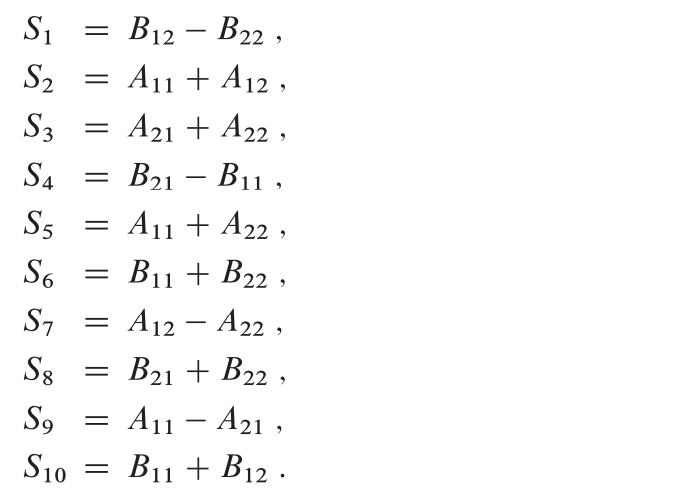
Strassen’s algorithm for matrix multiplication
How it works: Step 2
Step 1 is similar to the MULTIPLY-RECURSIVE procedure.
For step 2, this is the detail of 10 matrices created:

Slide 17
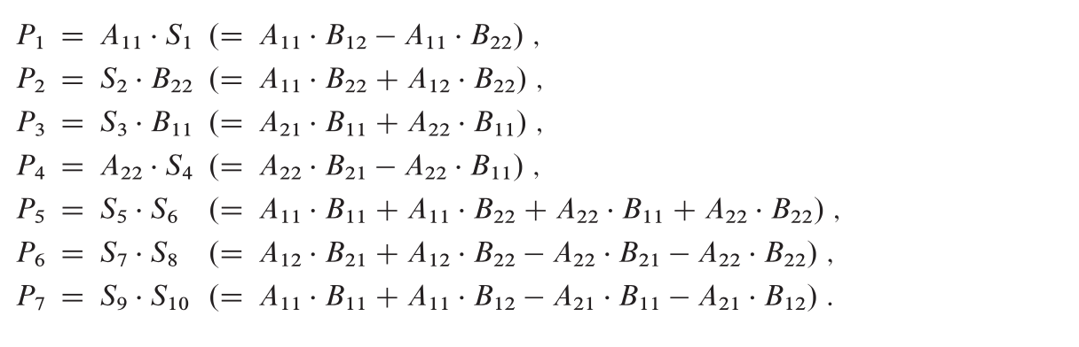
Strassen’s algorithm for matrix multiplication
How it works: Step 3
Step 3 recursively multiplies n/2 X n/2 matrices 7 times to compute the following matrices, each of which is the sum or difference of products of A and B submatrices:

Slide 18
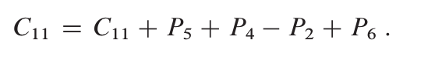
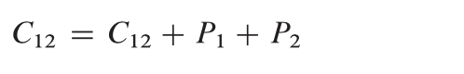
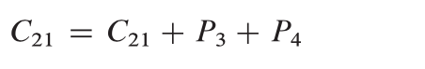
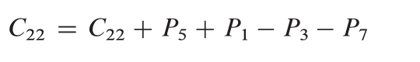

Strassen’s algorithm for matrix multiplication
How it works: Step 4
Update the four submatrices $C_{11},C_{12},C_{21}, C_{22}$ of the result matrix C by adding or subtracting various $P_{i}$matrices:

Slide 19

Strassen’s algorithm for matrix multiplication
How it works: Step 4
Hence, we obtain the following recurrence for the running time of Strassen’s algorithm:
$$T\left(n\right)=7T\left(n/2\right)+Θ(n^{2})$$
Which has the solution:
$$T\left(n\right)=Θ\left(n^{\lg{7}}\right)=O\left(n^{2.81}\right)=o(n^{3})$$
So, it beats the $Θ(n^{3})$ MATRIX-MULTIPLY and MATRIX-MULTIPLY-RECURSIVE procedures.

Slide 20
Summary
Another problem that we can use divide and conquer method to solve is the Matrix multiplication problem.
However, there exist Strassen’s algorithm which is faster asymptotically than the simple divide-and-conquer method.
Strassen’s algorithm works by eliminating one recursive multiplications of matrices using scalar subtractions and additions.

Slide 21
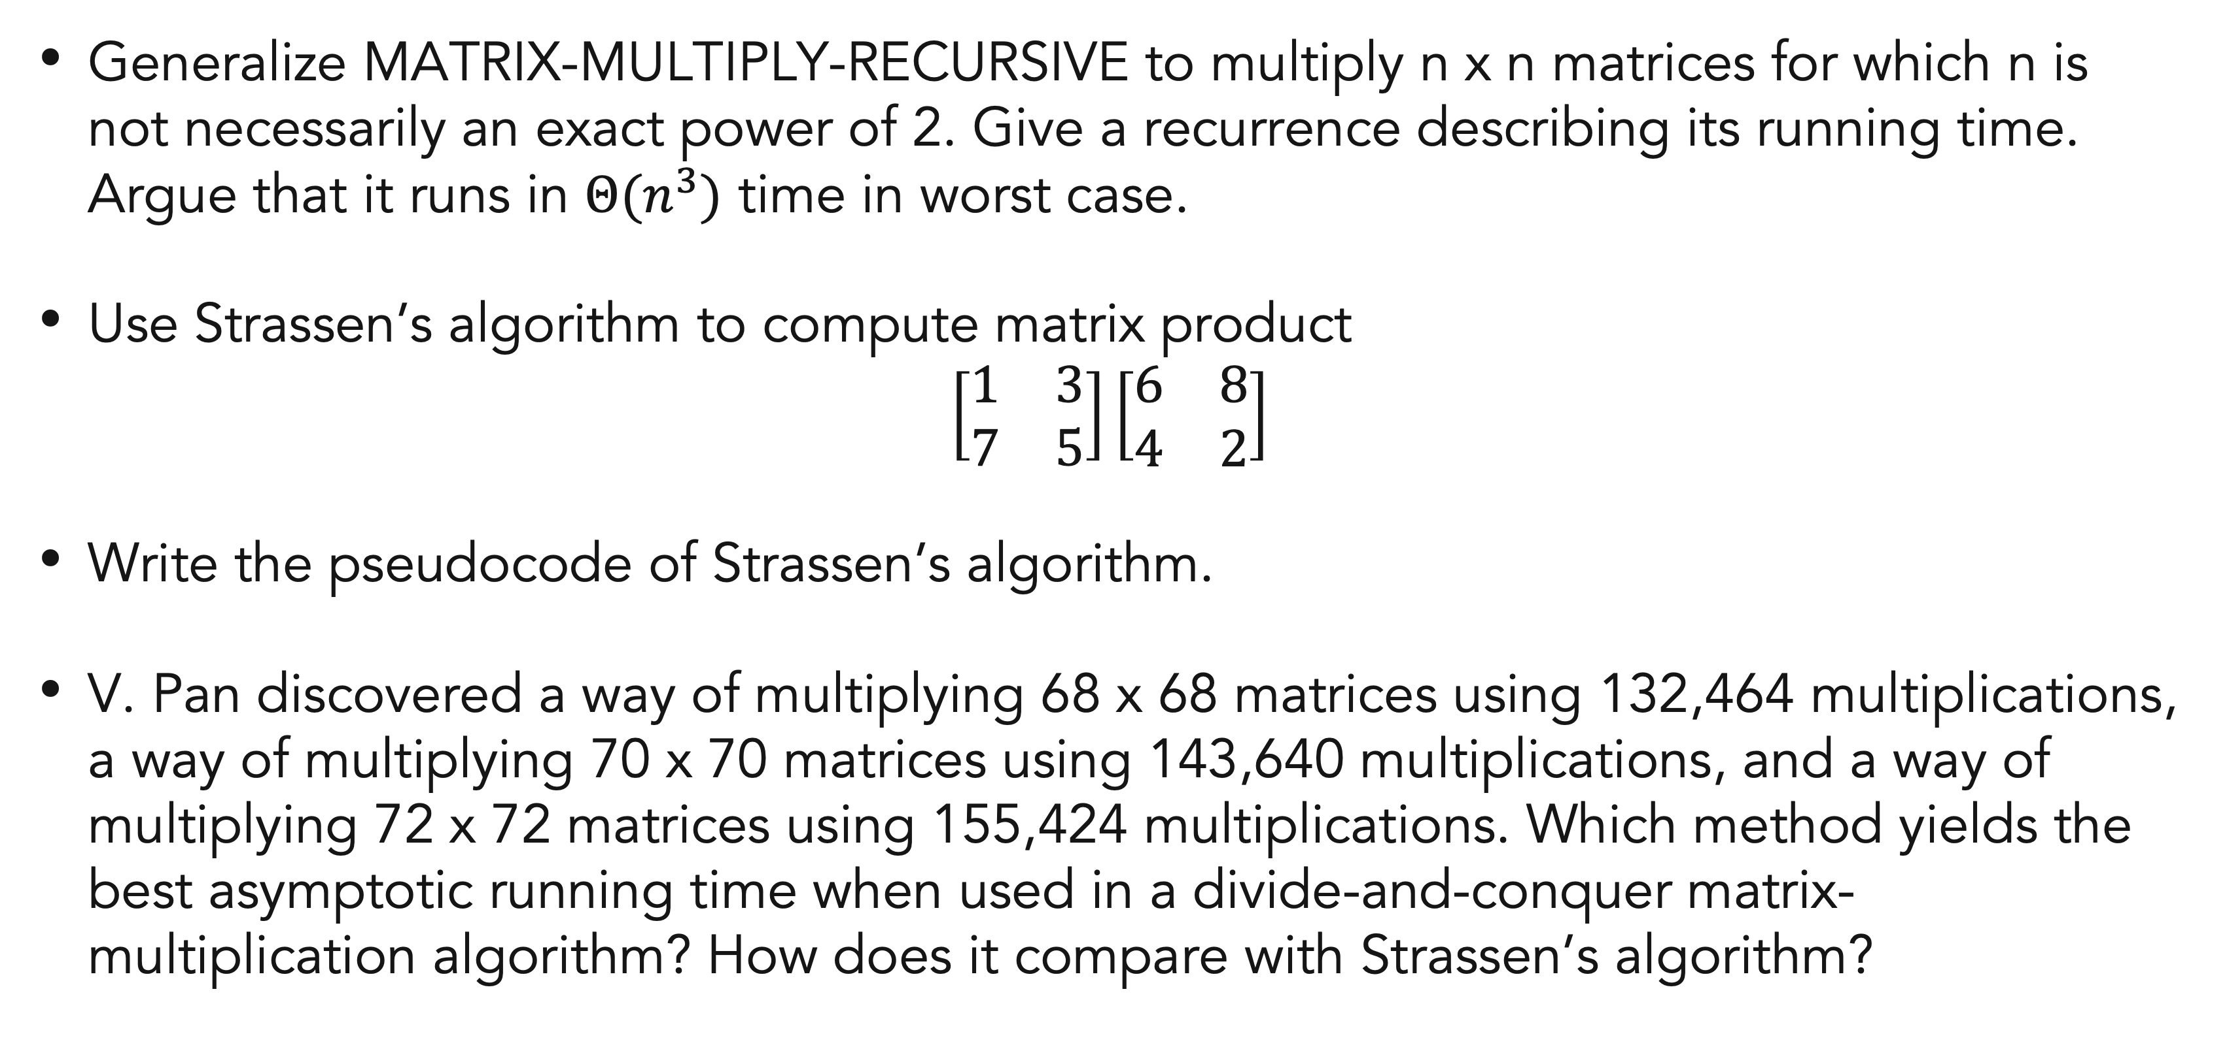
Exercises
07
Generalize MATRIX-MULTIPLY-RECURSIVE to multiply n x n matrices for which n is not necessarily an exact power of 2. Give a recurrence describing its running time. Argue that it runs in $Θ(n^{3})$ time in worst case.
Use Strassen’s algorithm to compute matrix product
$$\left[\begin{matrix}1 & 3 \\ 7 & 5\end{matrix}\right]\left[\begin{matrix}6 & 8 \\ 4 & 2\end{matrix}\right]$$
Write the pseudocode of Strassen’s algorithm.
V. Pan discovered a way of multiplying 68 x 68 matrices using 132,464 multiplications, a way of multiplying 70 x 70 matrices using 143,640 multiplications, and a way of multiplying 72 x 72 matrices using 155,424 multiplications. Which method yields the best asymptotic running time when used in a divide-and-conquer matrix-multiplication algorithm? How does it compare with Strassen’s algorithm?

Slide 22
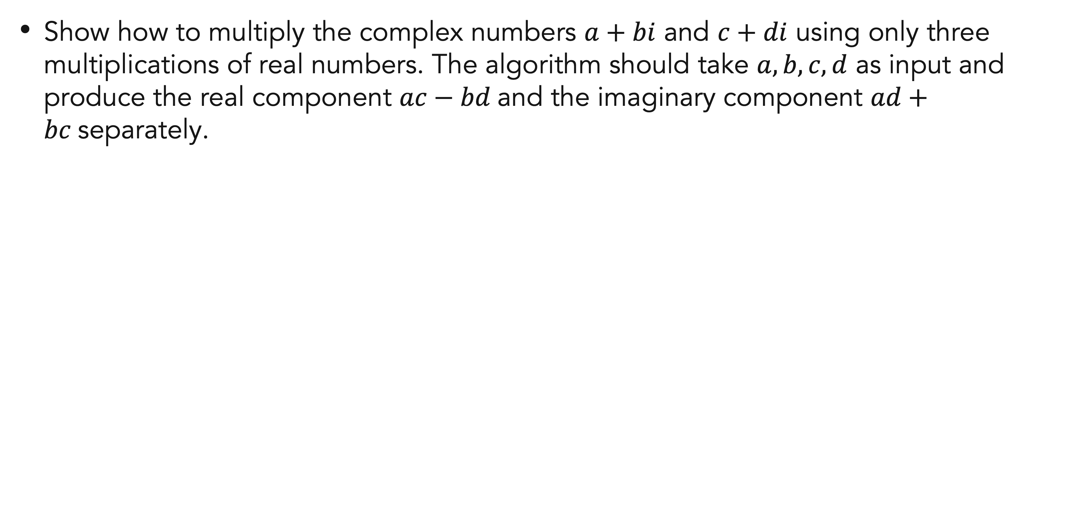
Exercises
07
Show how to multiply the complex numbers $a+bi$ and $c+di$ using only three multiplications of real numbers. The algorithm should take $a, b, c, d$ as input and produce the real component $ac−bd$and the imaginary component $ad+bc$separately.
Notes:
Complex numbers are the numbers that are expressed in the form of a+ib where, a,b are real numbers and 'i' is an imaginary number called “iota”. The value of i = (√-1).

Slide 23
References
Thomas H. Cormen. (2022). Introduction to algorithms: Fourth edition. The MIT Press. Chapter 4.
https://byjus.com/maths/complex-numbers/#:~:text=Complex%20numbers%20are%20the%20numbers,an%20imaginary%20number%20(Im).

Slide 24
Thank you
Divide and Conquer
September, 2023

